Slide 1
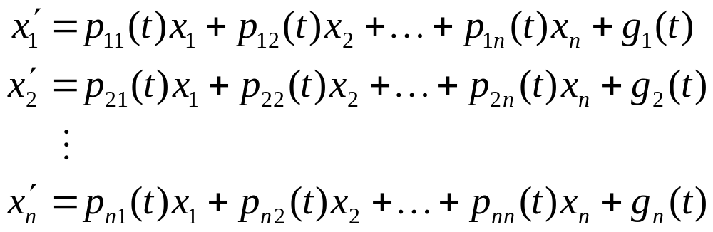
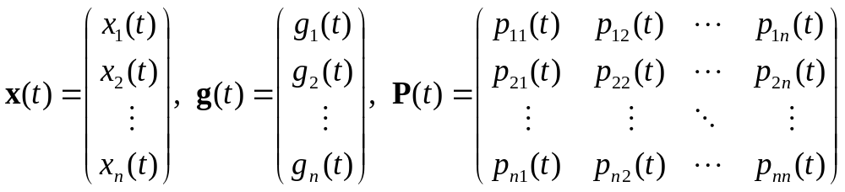
Ch 7.4: Basic Theory of Systems of First Order Linear Equations
The general theory of a system of n first order linear equations
parallels that of a single nth order linear equation.
This system can be written as x' = P(t)x + g(t), where

Slide 2

Vector Solutions of an ODE System
A vector x = φ(t) is a solution of x' = P(t)x + g(t) if the components of x,
satisfy the system of equations on I: α < t < β.
For comparison, recall that x' = P(t)x + g(t) represents our system of equations
Assuming P and g continuous on I, such a solution exists by Theorem 7.1.2.

Slide 3
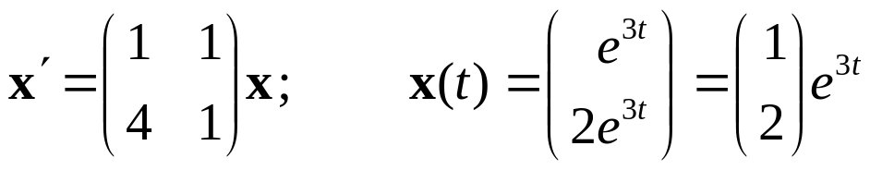
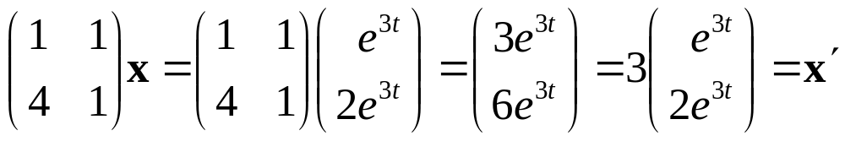
Example 1
Consider the homogeneous equation x' = P(t)x below, with the solutions x as indicated.
To see that x is a solution, substitute x into the equation and perform the indicated operations:

Slide 4
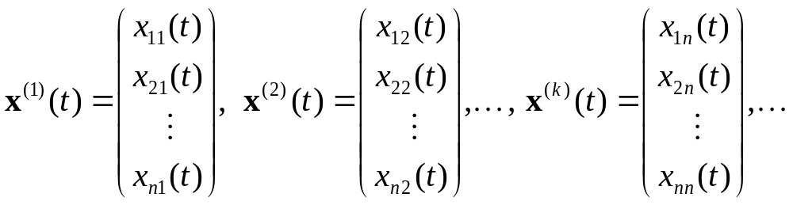
Homogeneous Case; Vector Function Notation
As in Chapters 3 and 4, we first examine the general homogeneous equation x' = P(t)x.
Also, the following notation for the vector functions
x⁽¹⁾, x⁽²⁾,…, x^{(k)},… will be used:

Slide 5

Theorem 7.4.1
If the vector functions x⁽¹⁾ and x⁽²⁾ are solutions of the system x' = P(t)x, then the linear combination c₁x⁽¹⁾ + c₂x⁽²⁾ is also a solution for any constants c₁ and c₂.
Note: By repeatedly applying the result of this theorem, it can be seen that every finite linear combination
of solutions x⁽¹⁾, x⁽²⁾,…, x^{(k)} is itself a solution to x' = P(t)x.

Slide 6
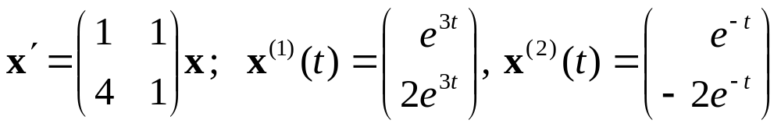
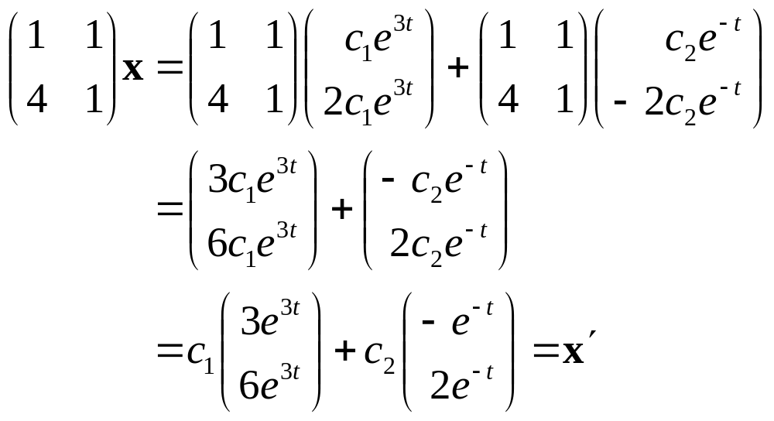
Example 2
Consider the homogeneous equation x' = P(t)x below, with the two solutions x⁽¹⁾ and x⁽²⁾ as indicated.
Then x = c₁x⁽¹⁾ + c₂x⁽²⁾ is also a solution:

Slide 7

Theorem 7.4.2
If x⁽¹⁾, x⁽²⁾,…, x^{(n)} are linearly independent solutions of the system x' = P(t)x for each point in I: α < t < β, then each solution x = φ(t) can be expressed uniquely in the form
If solutions x⁽¹⁾,…, x^{(n)} are linearly independent for each point in I: α < t < β, then they are fundamental solutions on I, and the general solution is given by

Slide 8
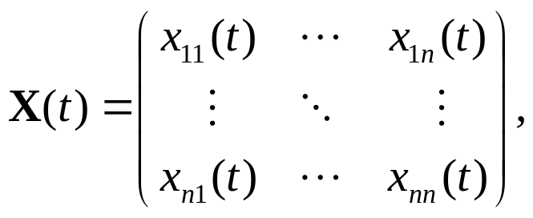
The Wronskian and Linear Independence
The proof of Thm 7.4.2 uses the fact that if x⁽¹⁾, x⁽²⁾,…, x^{(n)} are linearly independent on I, then detX(t) ≠ 0 on I, where
The Wronskian of x⁽¹⁾,…, x^{(n)} is defined as
W[x⁽¹⁾,…, x^{(n)}](t) = detX(t).
It follows that W[x⁽¹⁾,…, x^{(n)}](t) ≠ 0 on I iff x⁽¹⁾,…, x^{(n)} are linearly independent for each point in I.

Slide 9
Theorem 7.4.3
If x⁽¹⁾, x⁽²⁾,…, x^{(n)} are solutions of the system x' = P(t)x on I: α < t < β, then the Wronskian W[x⁽¹⁾,…, x^{(n)}](t) is either identically zero on I or else is never zero on I.
This result enables us to determine whether a given set of solutions x⁽¹⁾, x⁽²⁾,…, x^{(n)} are fundamental solutions by evaluating W[x⁽¹⁾,…, x^{(n)}](t) at any point t in α < t < β.

Slide 10
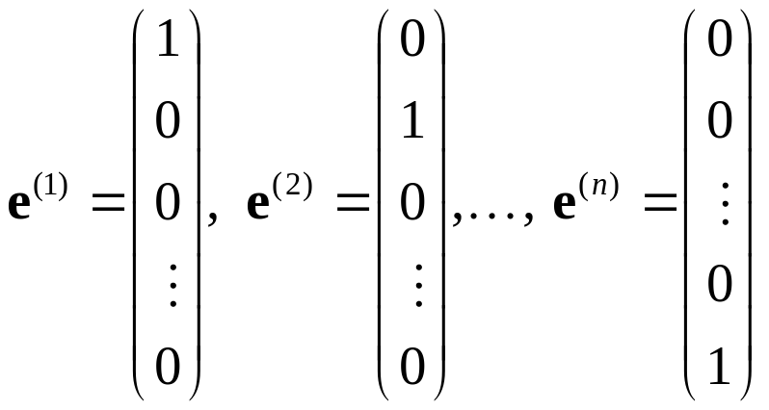

Theorem 7.4.4
Let
Let x⁽¹⁾, x⁽²⁾,…, x^{(n)} be solutions of the system x' = P(t)x,
α < t < β, that satisfy the initial conditions
respectively, where t₀ is any point in α < t < β. Then
x⁽¹⁾, x⁽²⁾,…, x^{(n)} are fundamental solutions of x' = P(t)x.

